Slide 1





Early Career Researchers and Open Health Knowledge
Peter Murray-Rust^{1,2}
[1]University of Cambridge[2]TheContentMine [peter@contentmine.org]
Open Science Week
NUI, Galway, IE, 2019-04-11
Early Career Researchers are building the
Advocacy, Community and Tools
needed to liberate medical knowledge.
Includes demos!

Slide 2
Illustrative theme
Elaine Toomey [1] wants to collect published knowledge on
“Childhood obesity prevention”
How can we use the current literature to find answers?
ECRs have fought for the right to search, and have built tools.
We’ll
search/download the literature (getpapers + EuropePMC).
Add semantics with Wikipedia and Wikidata
Let’s use these to get a sample, scoping answer within minutes
[1] http://www.nuigalway.ie/colleges-and-schools/arts-social-sciences-and-celtic-studies/staffprofiles/elainetoomey/

Slide 3
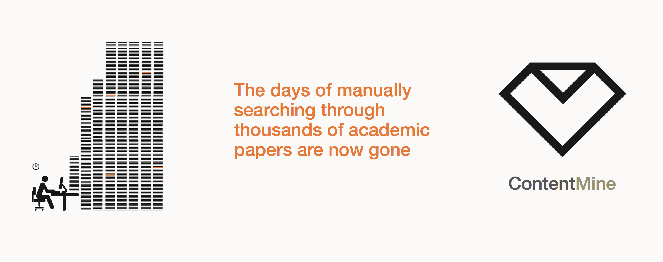
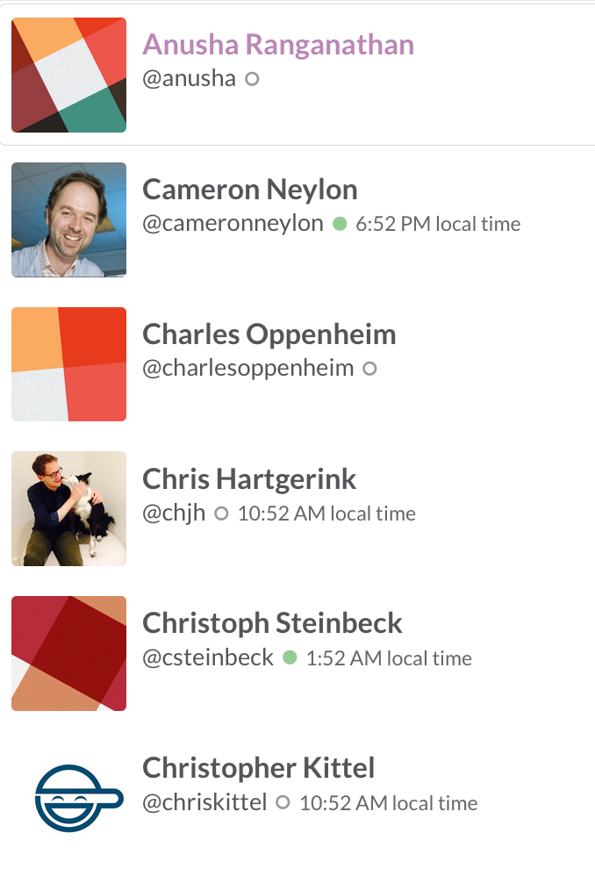
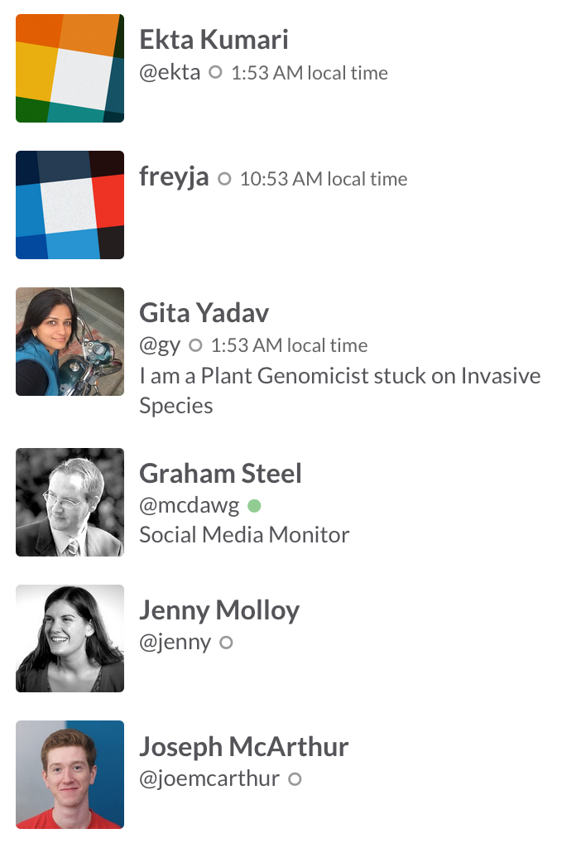
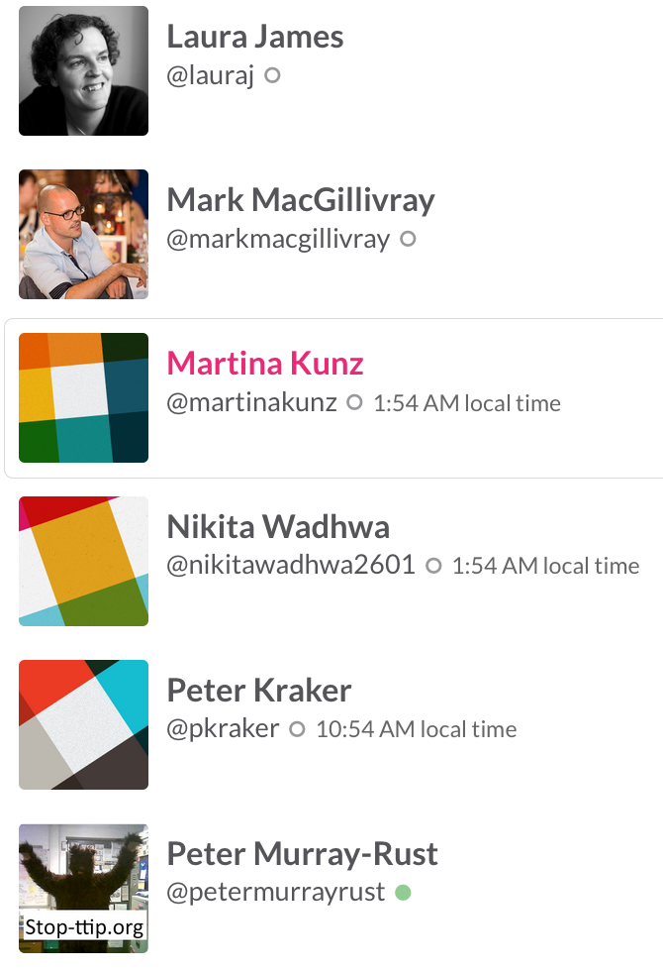
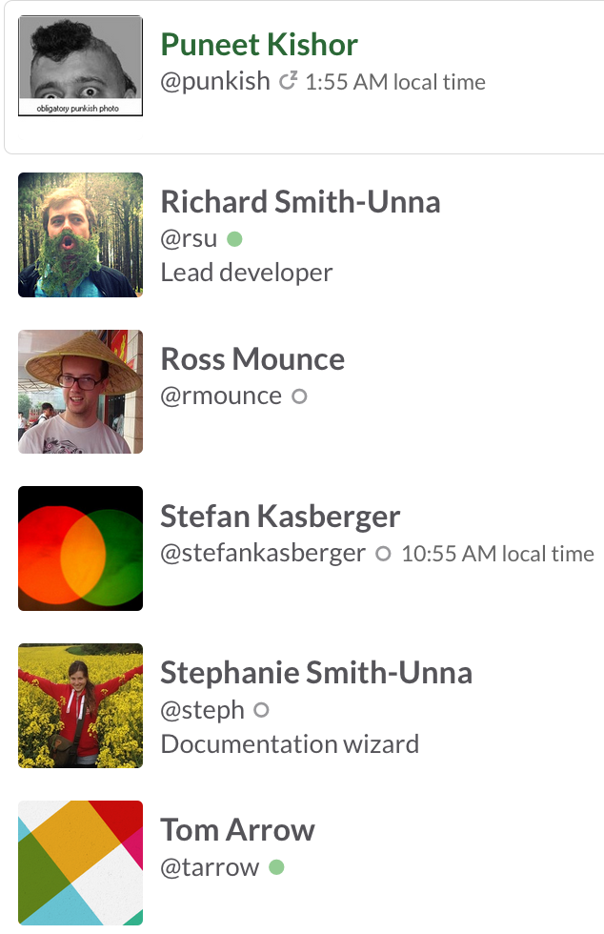
The Right to Read is the Right to Mine
Mining millions of Open facts every week
(2x digital music industry!)
ContentMine is an OpenLocked Non-Profit company

Slide 4
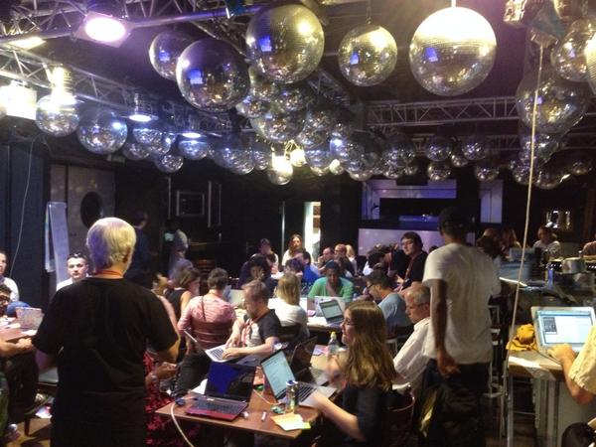
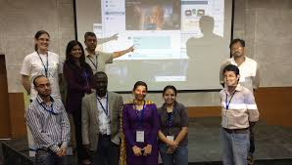
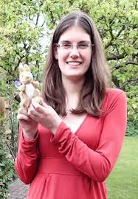
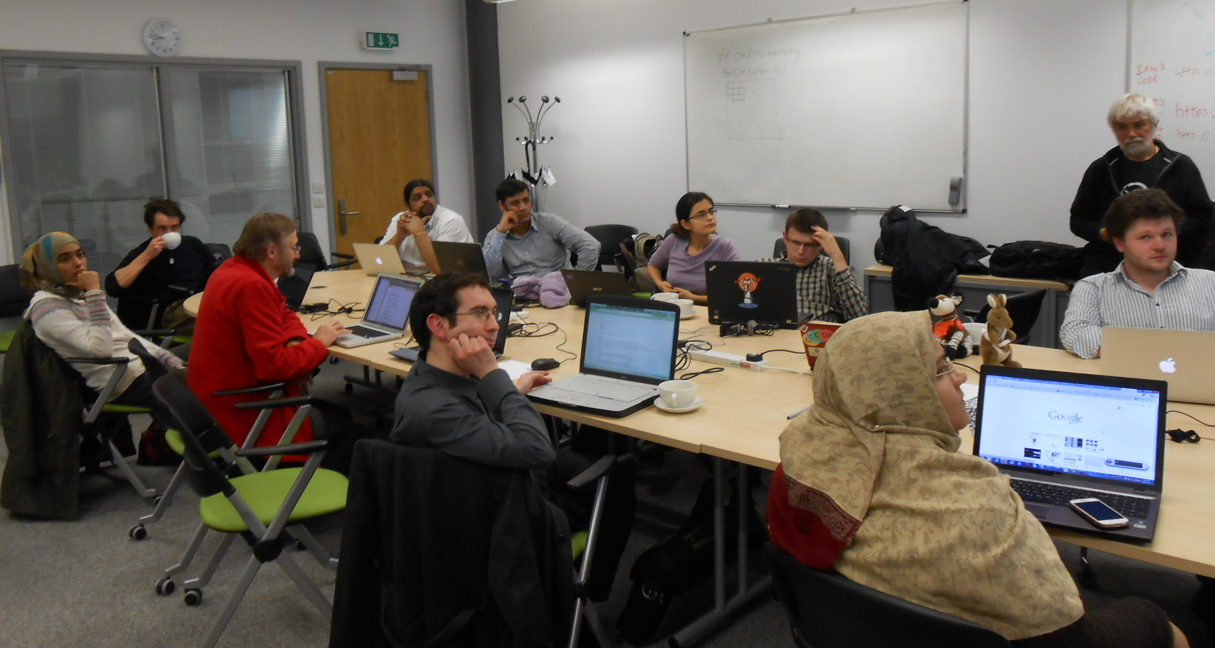
Berlin 2014
Gita Yadav + colleagues
Delhi 2014
Oxford 2013
Jenny Molloy with mascot AMI

Slide 5
Why Open?
Better
Quicker
Flexible
Inclusive
Preservable
Principled

Slide 6
Opening Knowledge overcomes injustice
Open comes from the heart.
Closed Access Means People Die.
Megacorporations are pwning the knowledge infrastructure/
The Right to Read is the Right to Mine
Young people change the world. Give them the chance.
ACT: Advocacy , Community, Tools

Slide 7
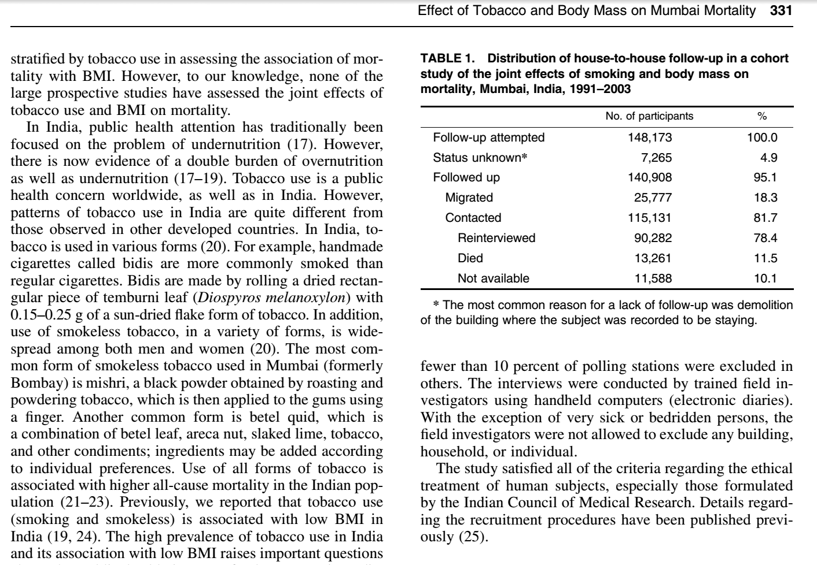
Polly: “there were 10,000 abstracts and due
to time pressures, we split this between 6 researchers. It took about 2-3 days of work (working only on this) to get through
~1,600 papers each. So, at a minimum this
equates to 12 days of full-time work (and would normally be done over several weeks under normal time pressures).”
ContentMine software can do this in a few minutes

Slide 8
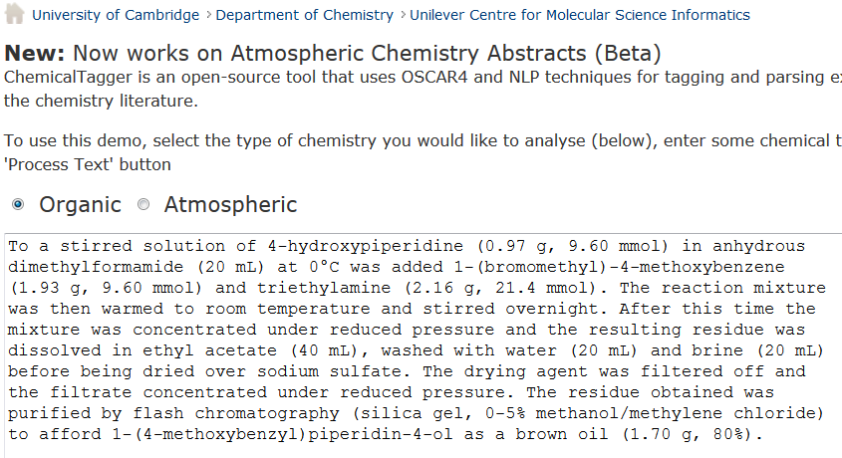
http://chemicaltagger.ch.cam.ac.uk/
Typical
Typical chemical synthesis

Slide 9
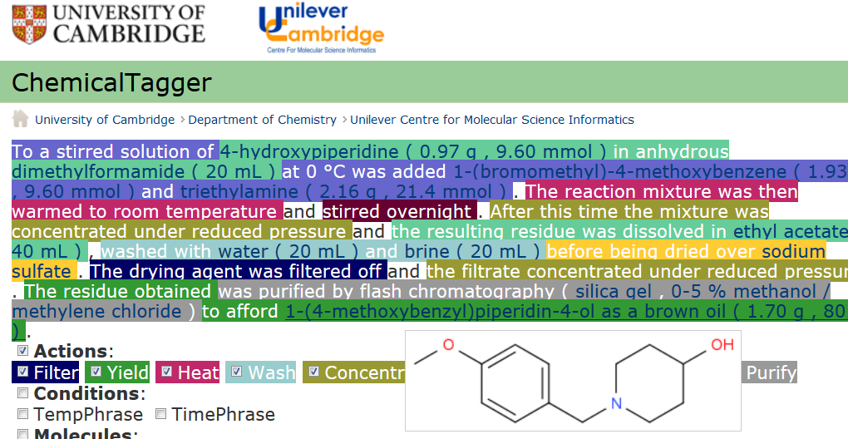
Automatic semantic markup of chemistry
Could be used for analytical, crystallization, etc.

Slide 10
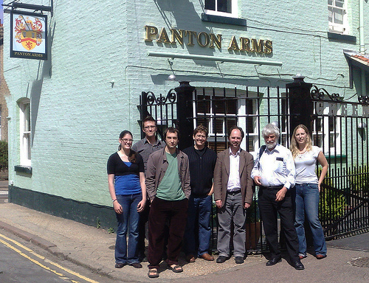
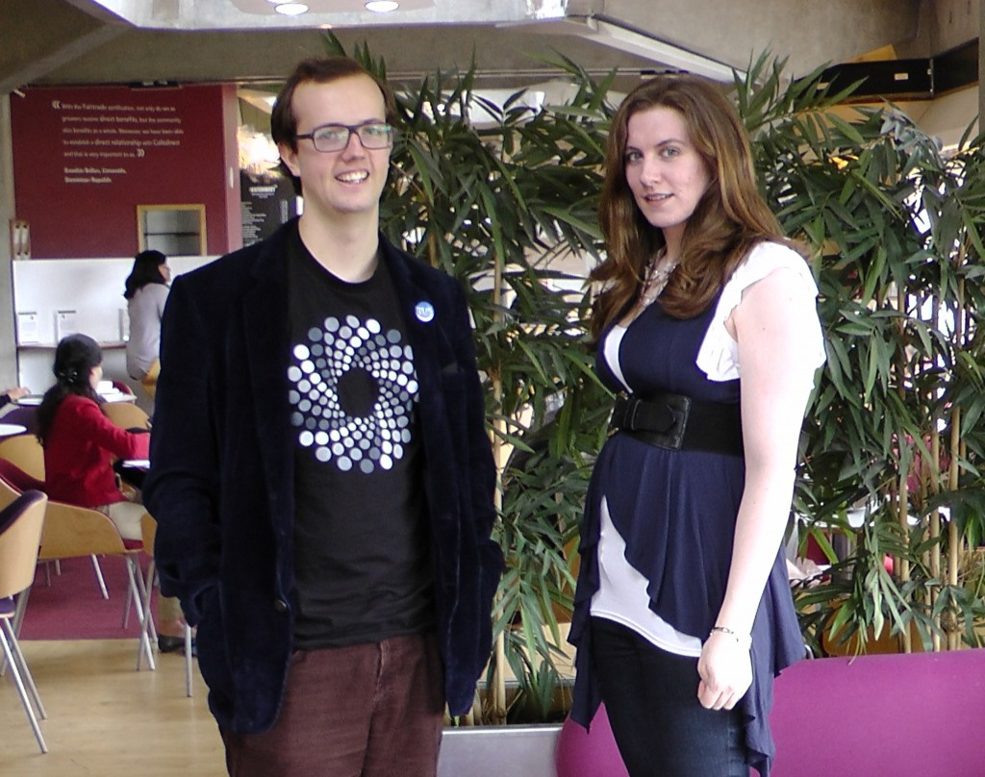
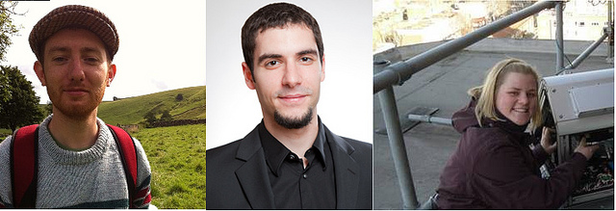
Panton Authors and Fellows

Slide 11
Ross Mounce
Bioscientist and palaeontologist
Tireless champion of Open and gadly of publishers

Slide 12

Sophie Kay-Kershaw
Developing reproducible computational research for biomedical graduates

Slide 13
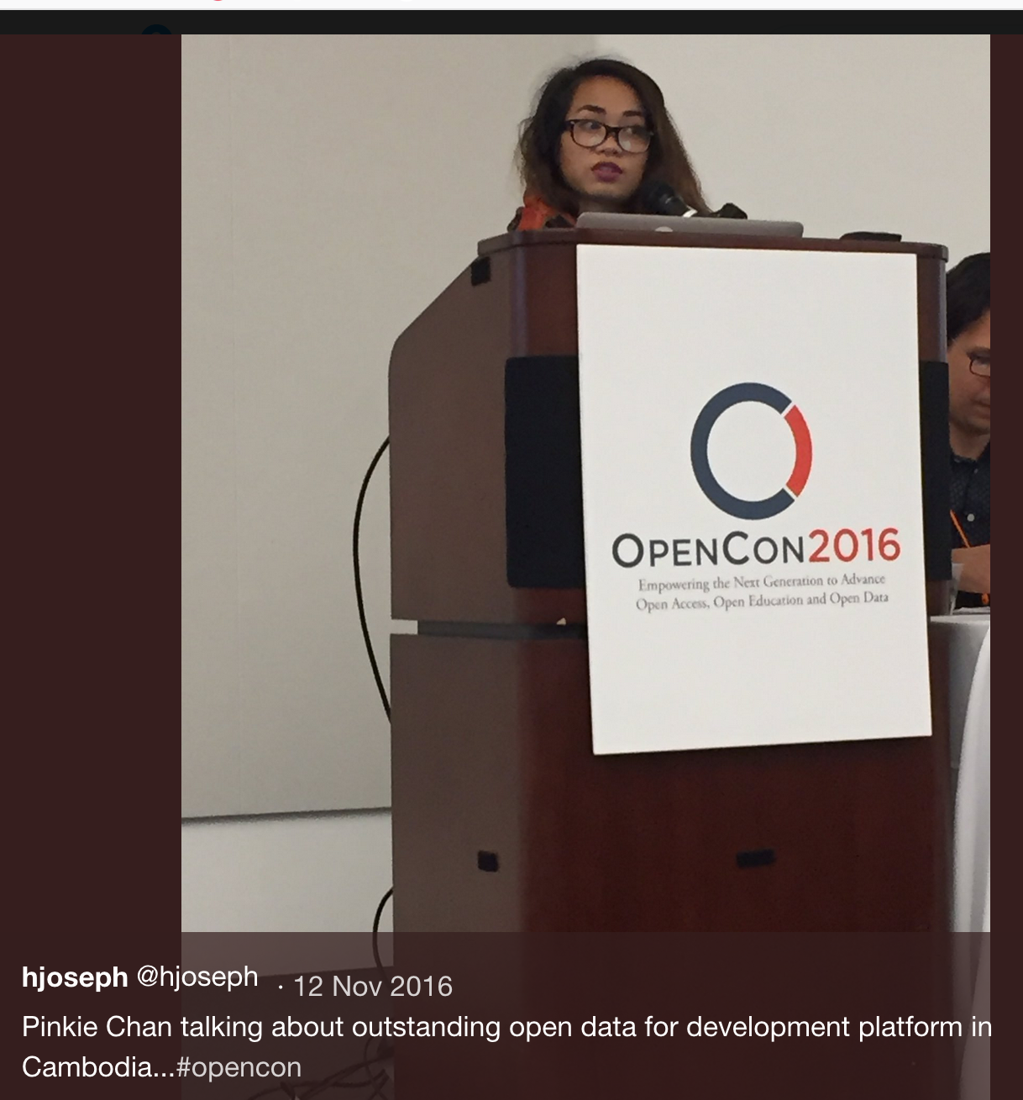
PMR’s Shuttleworth Flash Grantees
Erin McKiernan (Open Access)
Daniel Mietchen (Wikimedian)
Joe McArthur (Right to Research)
Chris Hartgerink (Text mining)
Pinkie Chan* (Fighting land grabs in Cambodia w OpenData)
Heather Piwowar (Impact Story, Unpaywall)
Sophie Kay-Kershaw (OSTI, reproducibility)
Corina Logan (Bullied into Bad Science)
Jon Tennant (Open Science MOOC)
Lorraine Chuen (Opencon)

Slide 14
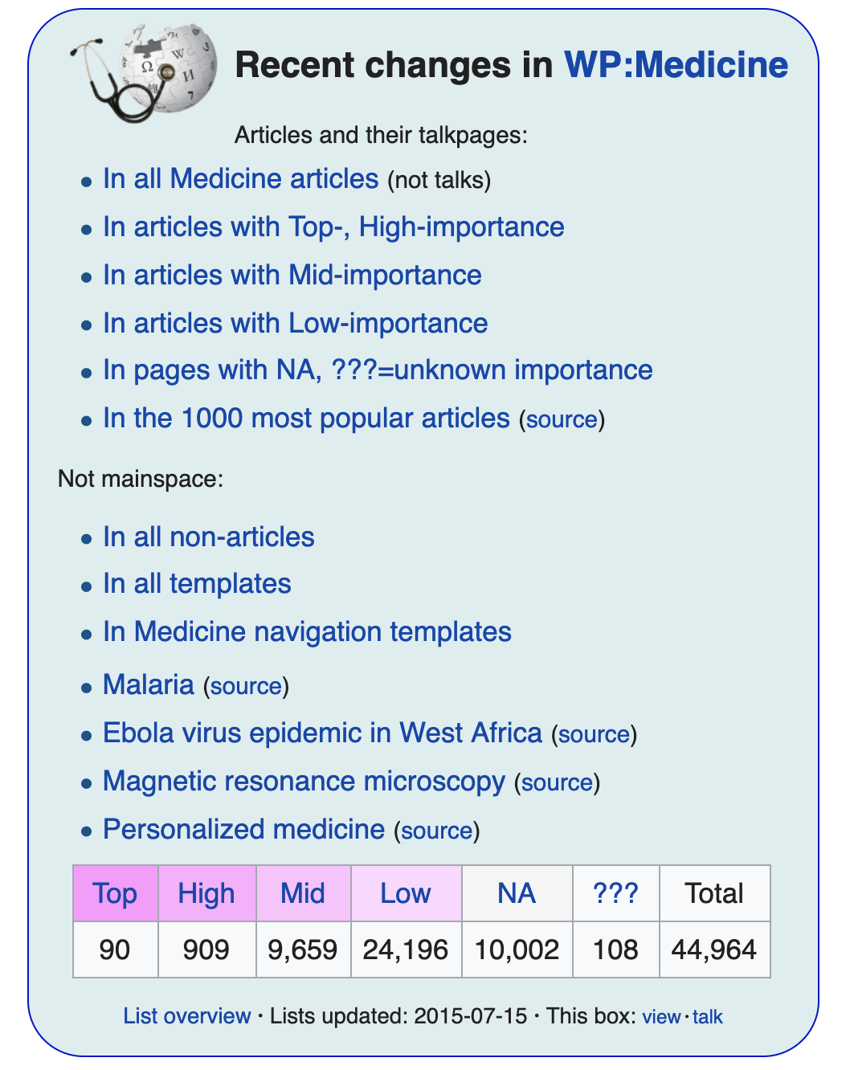
Daniel Mietchen, Wiki-star
https://en.wikipedia.org/wiki/Wikipedia:Wikipedia_Signpost/2011-07-25/Wikimedian_in_Residence_interview
https://en.wikipedia.org/wiki/User:Daniel_Mietchen
https://commons.wikipedia.org/wiki/User:Daniel_Mietchen
Thesupermat - Own work Intervention de Daniel Mietchen aux Rencontres Wikimedia France. CC BY-SA 3.0
File:Rencontres Wikimedia France - Intervention de Daniel Mietchen.JPG Created: 4 December 2010

Slide 15
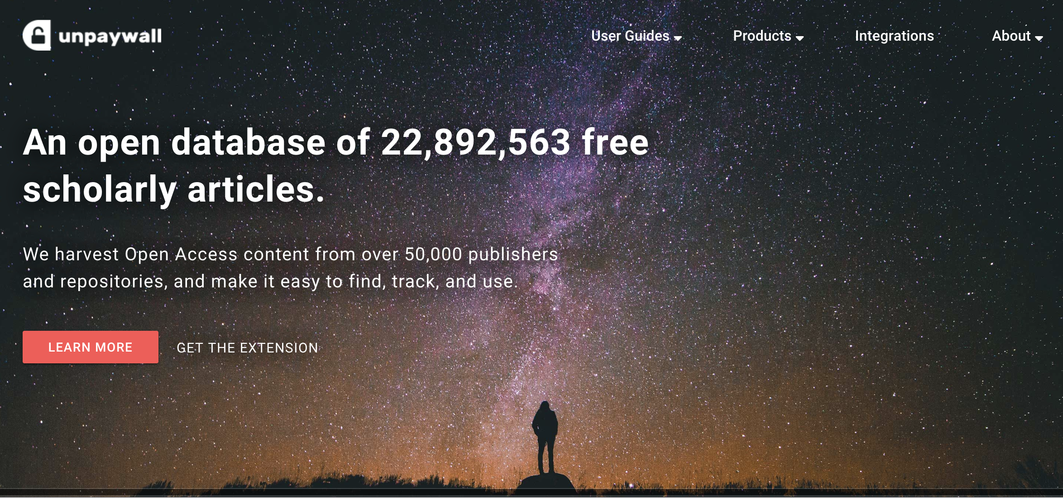
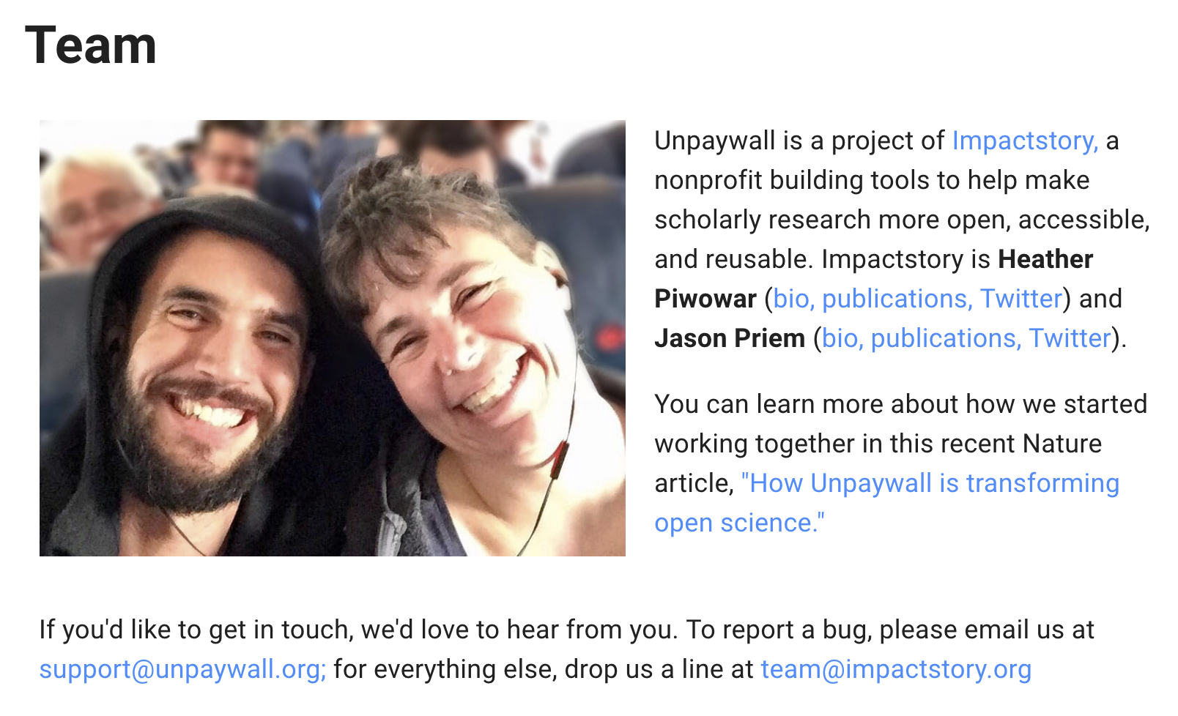

Slide 16
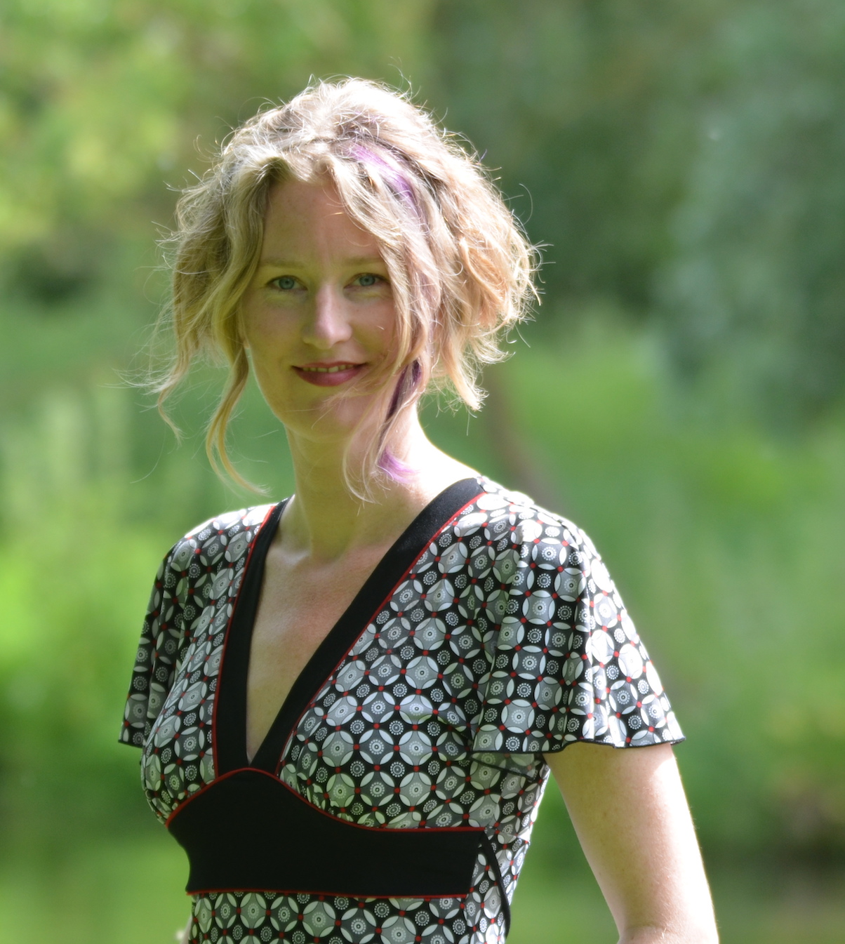
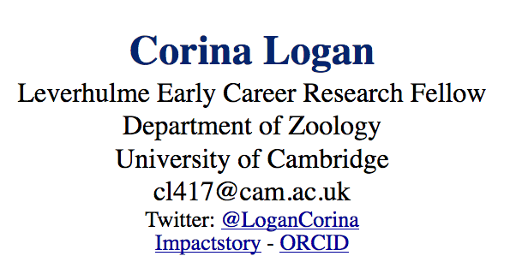
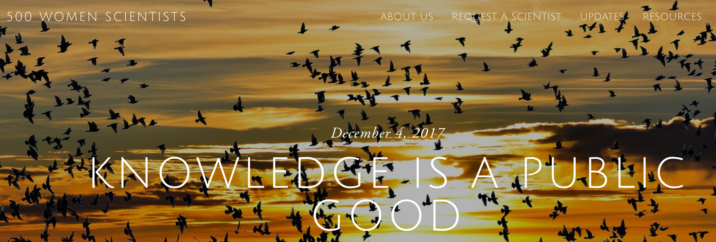
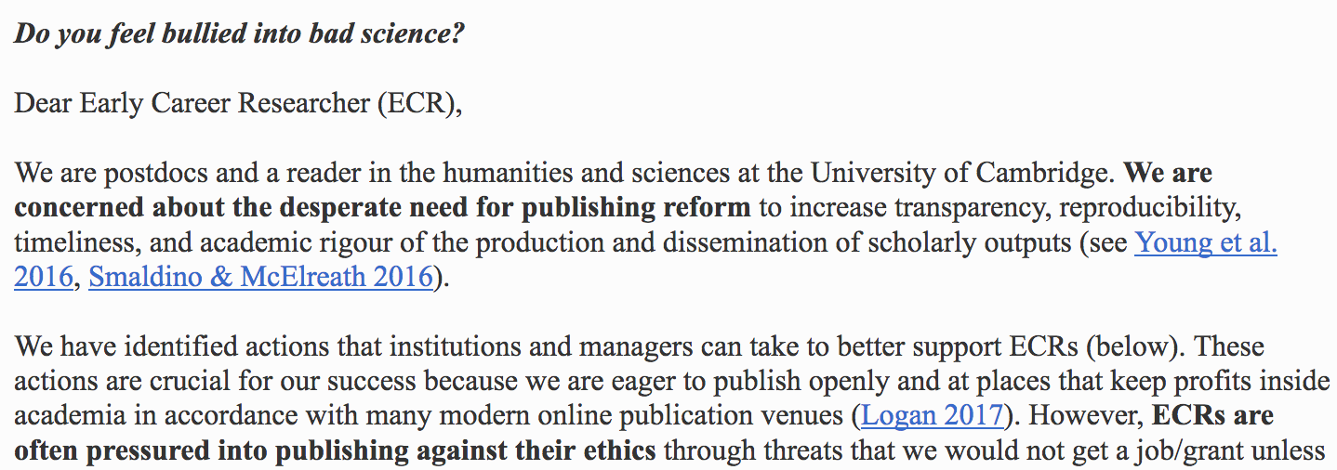
KNOWLEDGE IS A PUBLIC GOOD

Slide 17
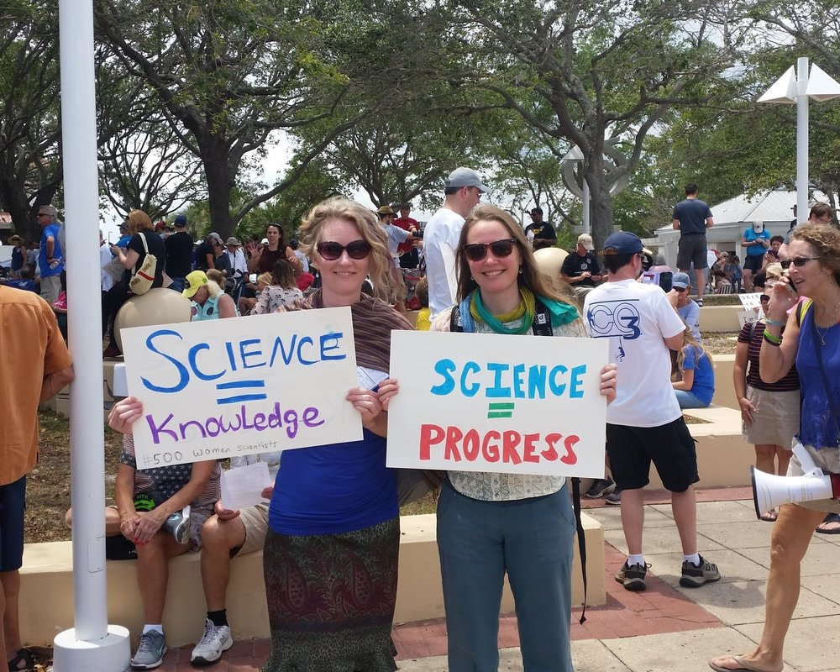

Slide 18

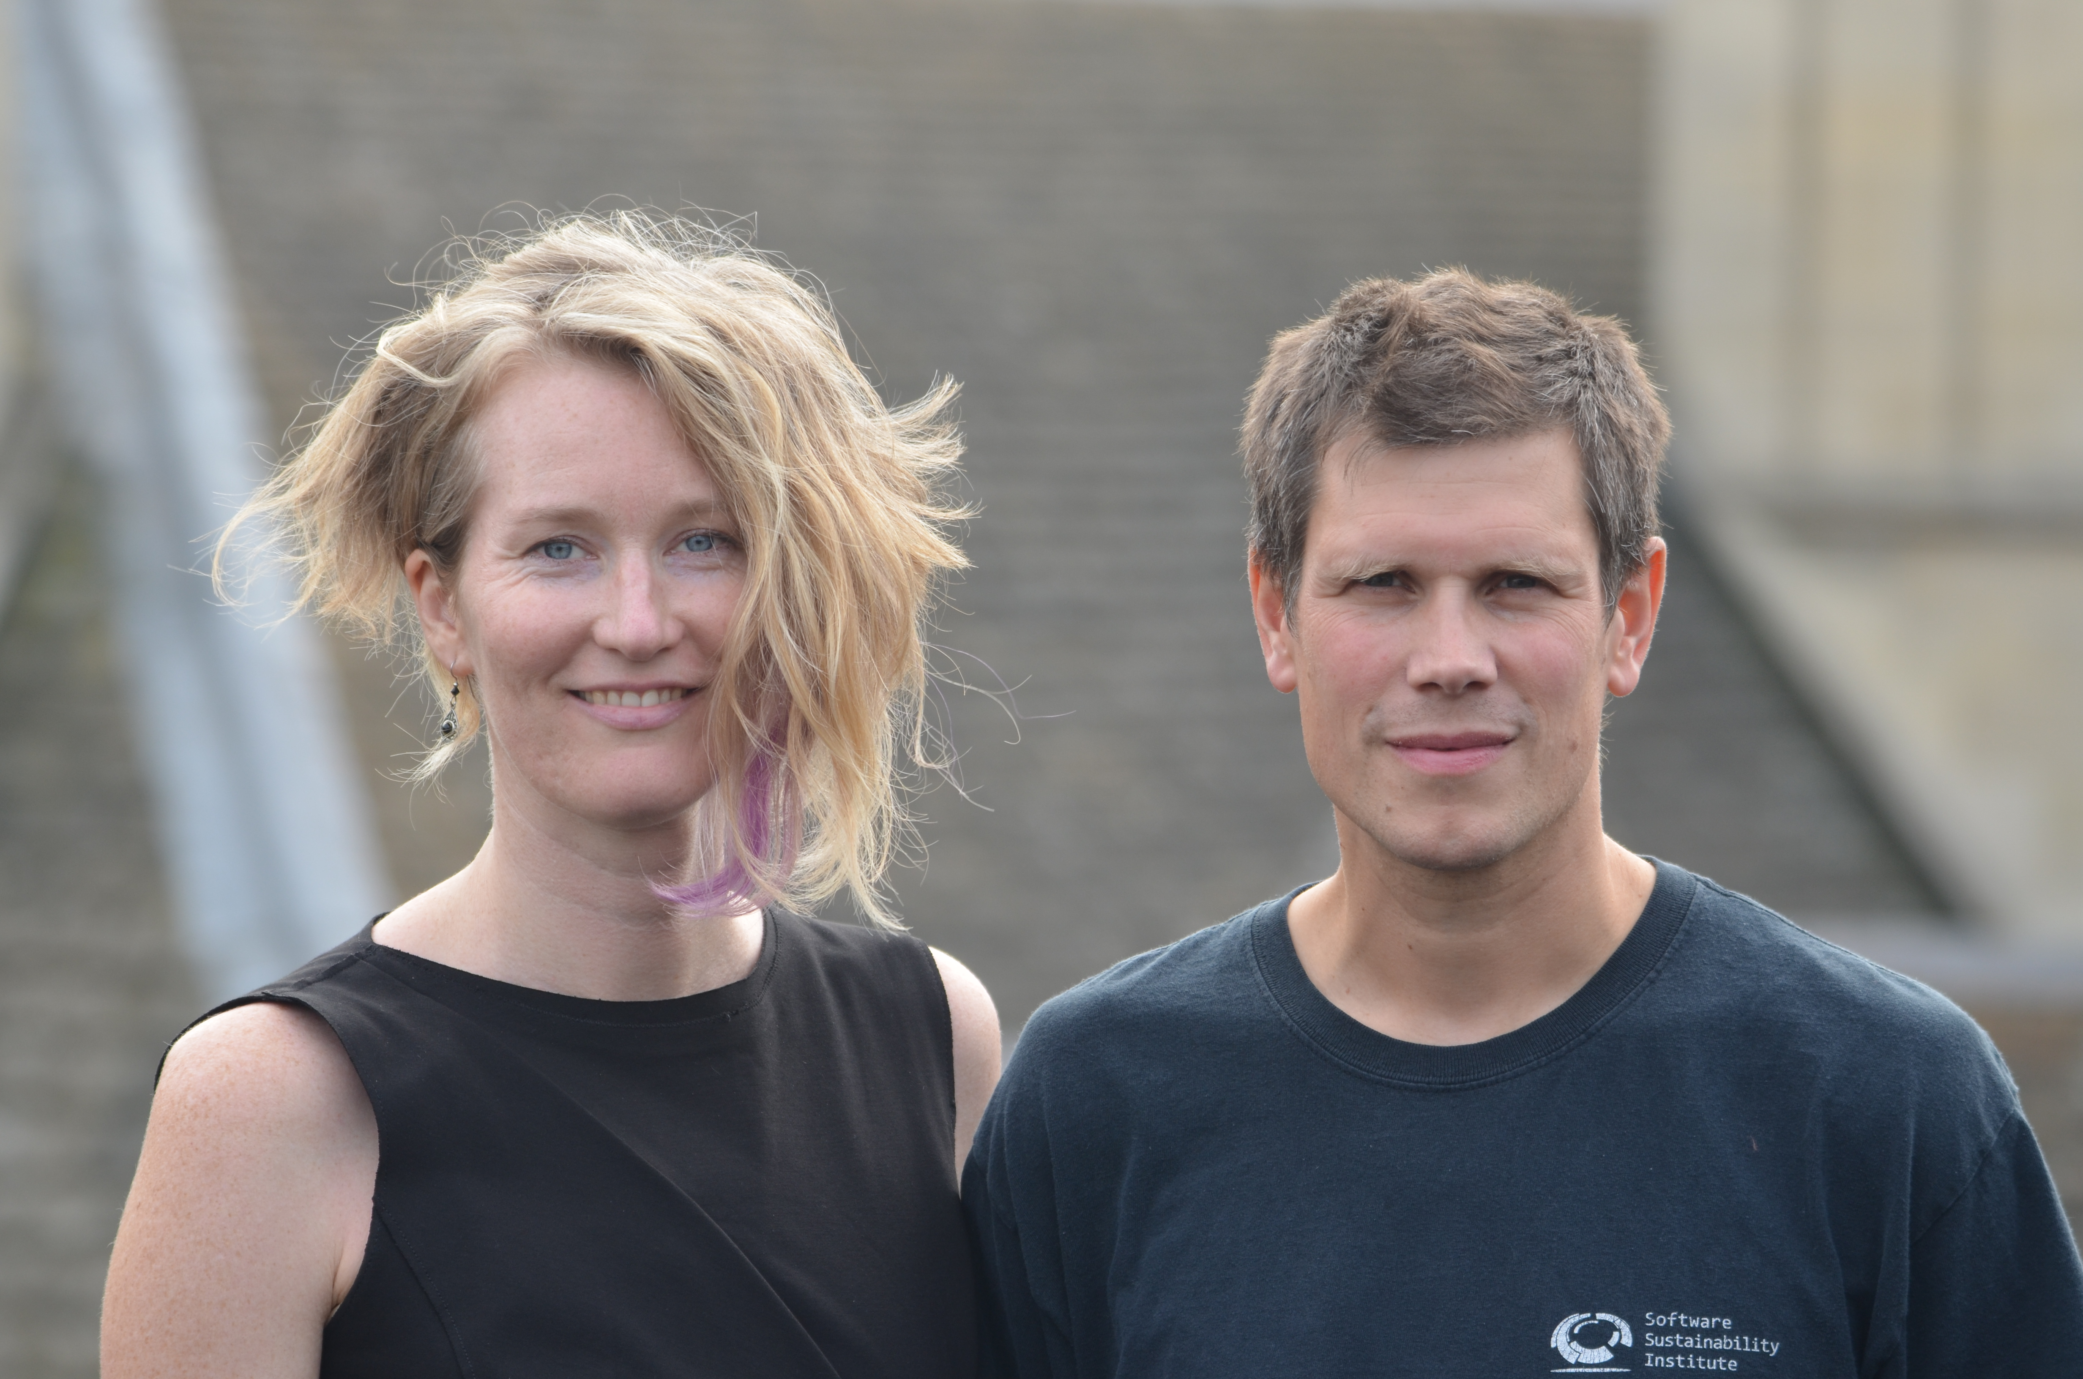
We won’t be…
Leading individuals and institutions in adopting open practices to improve research rigor
Corina Logan & Laurent Gatto
ECRs often feel pressured into taking actions against our ethics to pursue an academic career
(e.g., publishing in particular journals)
ECRs: Sign the petition to help us change academic culture
Non-ECRs: Join the supporters by valuing open practices, especially when making decisions about hiring, promotion, and grants
BIBS Leading Team: Dr. Laurent Gatto, Dr. Ross Mounce, Dr. Stephen Eglen, Dr. Adrian Currie, Dr. Lauren Maggio
www.BulliedIntoBadScience.org | Twitter: #BulliedIntoBadScience

Slide 19
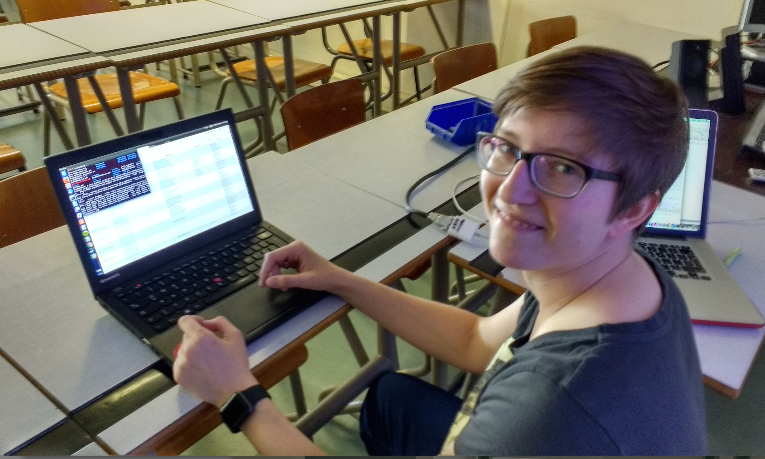
Julia Reda, Pirate MEP, running ContentMine software to liberate science 2016-04-16

Slide 20
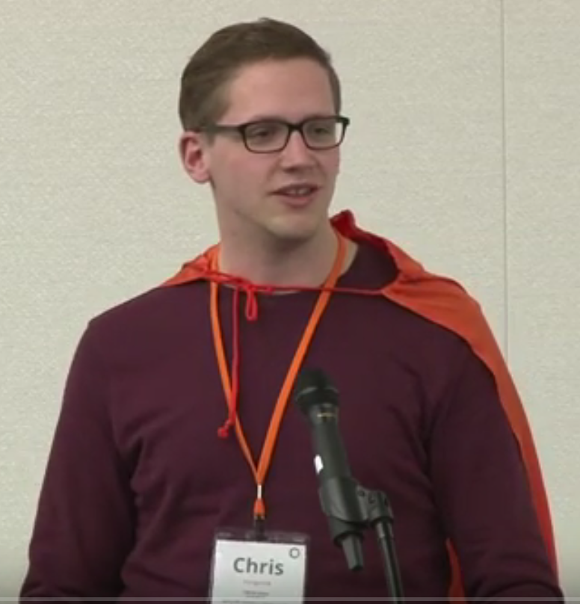
Chris Hartgerink
Tilburg University (NL)
Reproducible Science
Extracting statistical information
Helping authors check
reported results
Detecting problematic study
results (e.g., clinical trials)

Slide 21
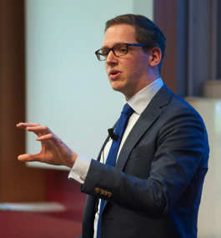
Elsevier stopped me doing my research
Chris Hartgerink
@Senficon (Julia Reda) :Text & Data mining in times of #copyright maximalism:
"Elsevier stopped me doing my research" http://onsnetwork.org/chartgerink/2015/11/16/elsevier-stopped-me-doing-my-research/ … #opencon #TDM

Slide 22
Chris Hartgerink’s blog post
I am a statistician interested in detecting potentially problematic research such as data fabrication, which results in unreliable findings and can harm policy-making, confound funding decisions, and hampers research progress.
To this end, I am content mining results reported in the psychology literature. Content mining the literature is a valuable avenue of investigating research questions with innovative methods. For example, our research group has written an automated program to mine research papers for errors in the reported results and found that 1/8 papers (of 30,000) contains at least one result that could directly influence the substantive conclusion [1].
In new research, I am trying to extract test results, figures, tables, and other information reported in papers throughout the majority of the psychology literature. As such, I need the research papers published in psychology that I can mine for these data. To this end, I started ‘bulk’ downloading research papers from, for instance, Sciencedirect. I was doing this for scholarly purposes and took into account potential server load by limiting the amount of papers I downloaded per minute to 9. I had no intention to redistribute the downloaded materials, had legal access to them because my university pays a subscription, and I only wanted to extract facts from these papers.
Full disclosure, I downloaded approximately 30GB of data from Sciencedirect in approximately 10 days. This boils down to a server load of 0.0021GB/[min], 0.125GB/h, 3GB/day.
Approximately two weeks after I started downloading psychology research papers, Elsevier notified my university that this was a violation of the access contract, that this could be considered stealing of content, and that they wanted it to stop. My librarian explicitly instructed me to stop downloading (which I did immediately), otherwise Elsevier would cut all access to Sciencedirect for my university.
I am now not able to mine a substantial part of the literature, and because of this Elsevier is directly hampering me in my research.
[1] Nuijten, M. B., Hartgerink, C. H. J., van Assen, M. A. L. M., Epskamp, S., & Wicherts, J. M. (2015). The prevalence of statistical reporting errors in psychology (1985–2013). Behavior Research Methods, 1–22. doi: 10.3758/s13428-015-0664-2

Slide 23
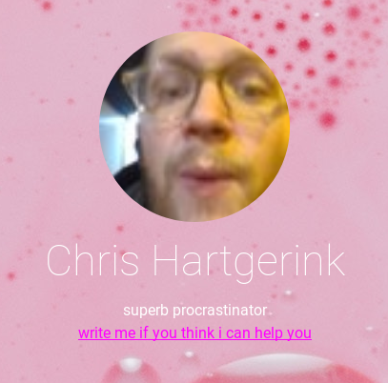

Open (to me) is...
* redistributing resources
* improving (e)quality
Advice
* All problems nested in a bigger problem; what’s the bigger problem for what you’re trying to address?
* Personal, empathetic growth is key to growing more open (email if you’d like to chat)
Working on…
* creating an *open* scholarly communication infrastructure that makes research fun
* disregarding stakeholder engagement (promotes the already powerful players)
chris@libscie.org
@chartgerink

Slide 24
6 ContentMine Fellows for 6 months

Slide 25
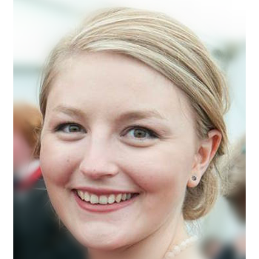
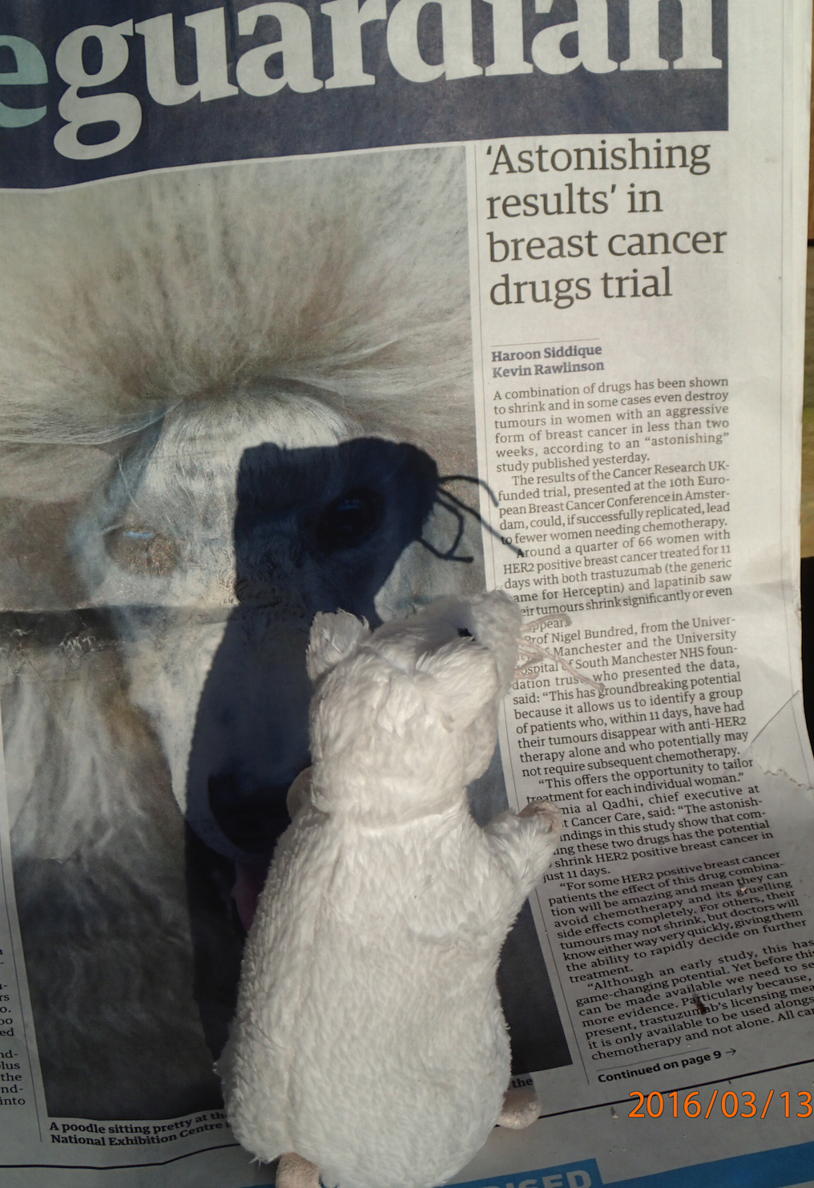
Alexandra Bannach-Brown
Edinburgh, Neuroscience
Problem: huge body of works in animal studies about depressions. systematic review is the main approach for getting insight.
Wants: identify papers in systematic review of depressive behaviour in animals. What drugs, what methods, what outcomes and signs/phenotypes. Use outcomes for document clustering.
and expedite scientific advances."
Corpus: 70.000 Papers

Slide 26

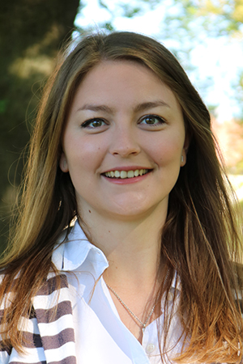




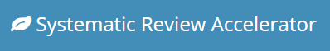
Alexandra Bannach-Brown
Contact:
Twitter: @ABannachBrown
Email: Alexandra_bannachbrown@bond.edu.au
To me, Open Science is…
ensuring your work transparent & reproducible
ensuring the knowledge you create is open & accessible
Research Fellow in Automation of Evidence Synthesis
Centre for Research in Evidence-Based Practice, Bond University
ContentMine Fellow 2016: Animal Models of Depression
AMI Dictionaries: Anti-depressants
Automation Tools for Medical & Biomedical Reviews
SyRF (CAMARADES, Edinburgh) – SyRF.org.uk
Systematic Review Accelerator (CREBP, Bond Uni) CREBP-SRA.com & Github

Slide 27
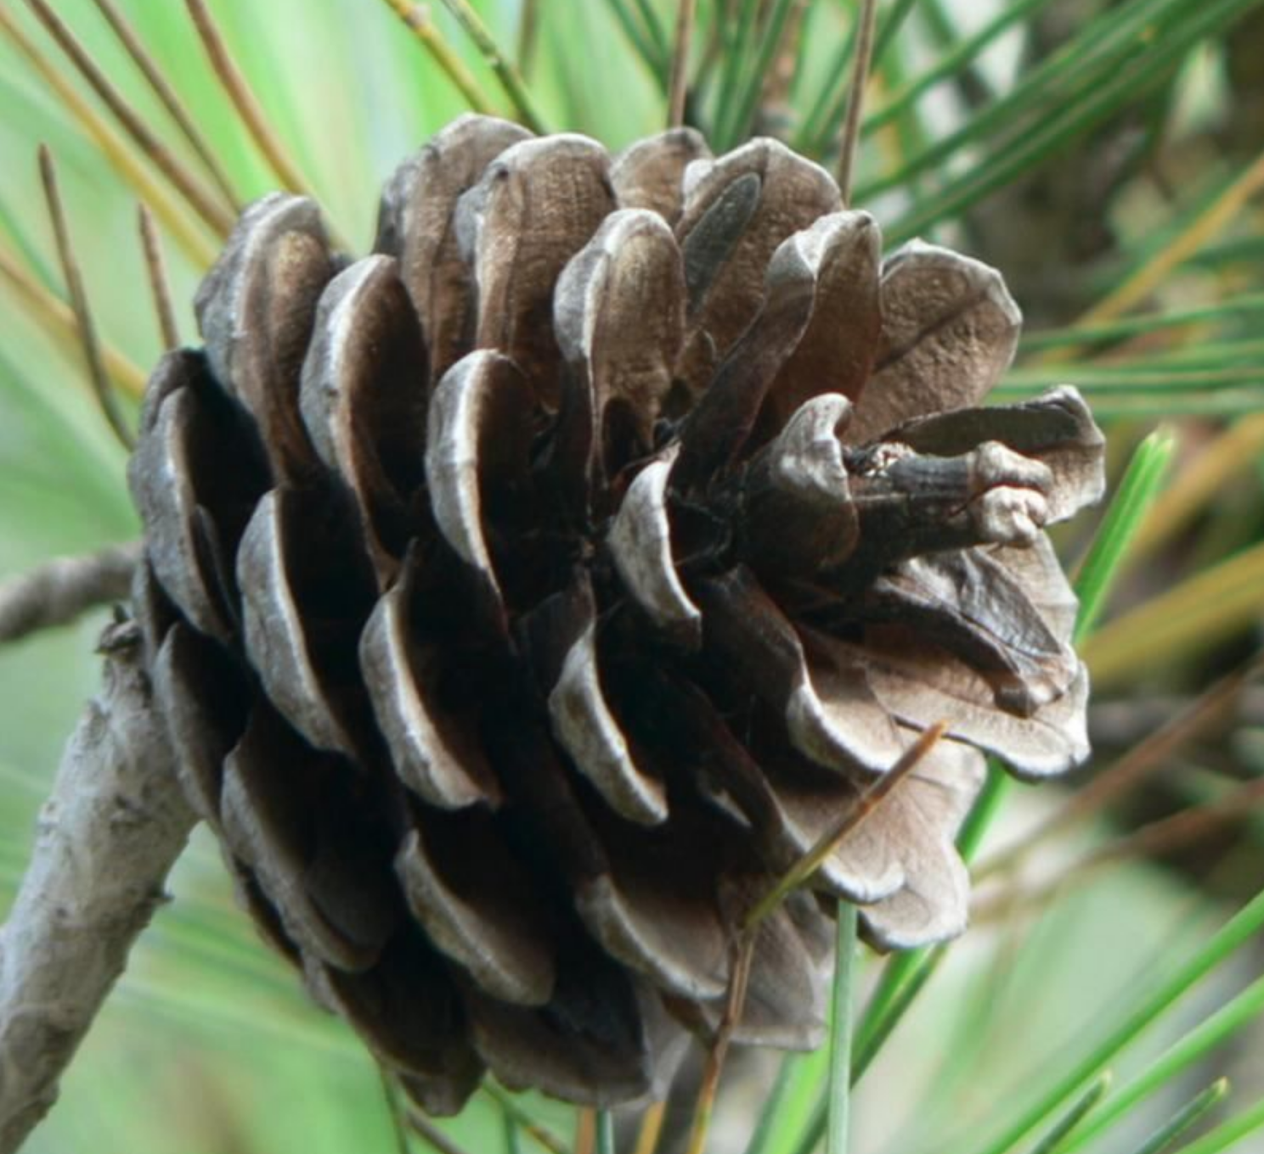
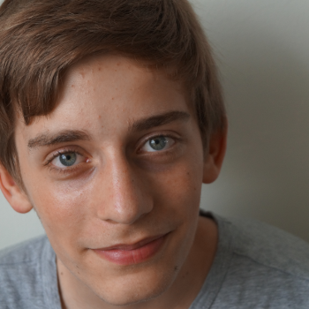
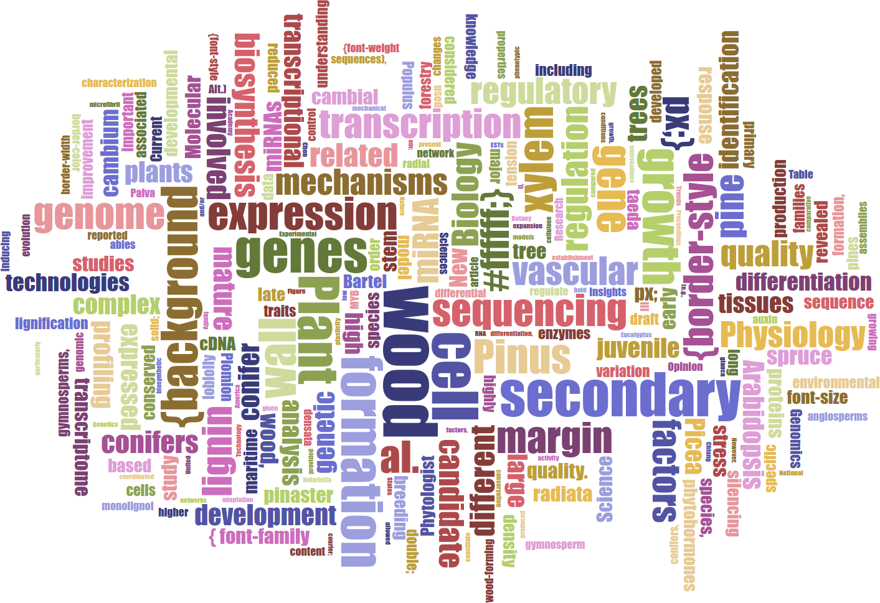
Lars Willighagen
15 years old NL
Wants: extract data about conifers (relations to chemicals, height etc.)
Outcome: database with webpage containing conifer properties
Table Facts Visualiser DEMO
Card DEMO
Word Cloud
„ I applied to this fellowship to learn new things and combine the ContentMine with two previous projects I never got to finish, and I got really excited by the idea and the ContentMine at large.“

Slide 28
OpenKnowledgeMaps
Peter Kraker[1] and colleagues, Austria
Open; protected against takeover by Austrian Law
Unsupervised machine learning on Open Access
Easy to use
Vibrant community
http://openknowledgemaps.org
[1] Panton Fellow

Slide 29
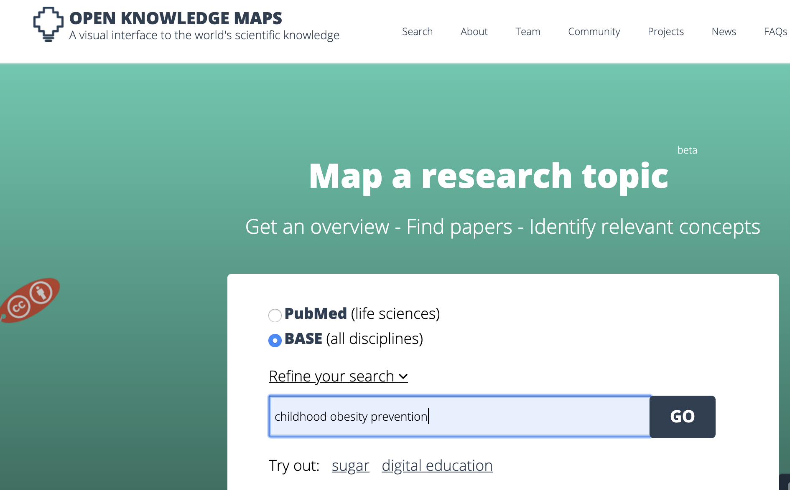
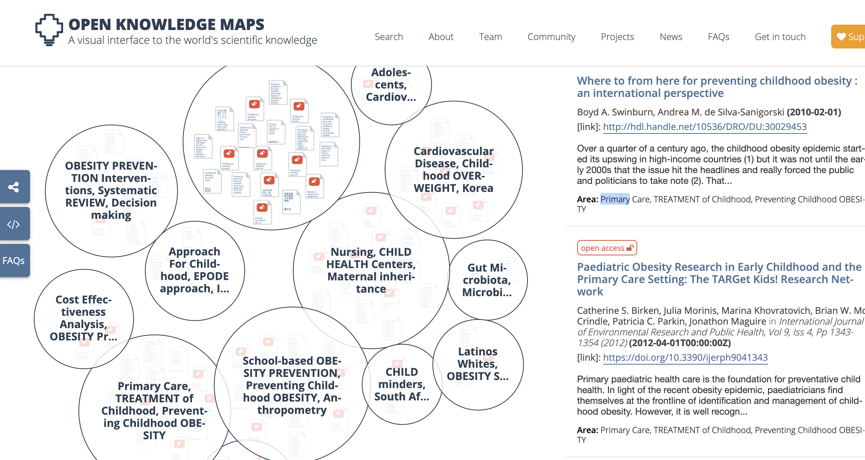
Peter Kraker and team
http://openknowledgemaps.org
Let’s ask for “childhood obesity prevention”

Slide 30
ContentMine software
Open Source, platform-independent, free
Tutorial material [1]
getpapers search and download [2]
ami dictionary-based search and analysis [3]
Explicit use of Wikipedia and Wikidata
[1] (http://github.com/petermr/tigr2ess ) example shows crops in India but easily extensible to most disciplines
[2] Rik Smith-Unna; http://github.com/ContentMine/getpapers, Node.js
[2] Peter Murray-Rust; http://gikhub.com/ContentMine/normami , Java7

Slide 31
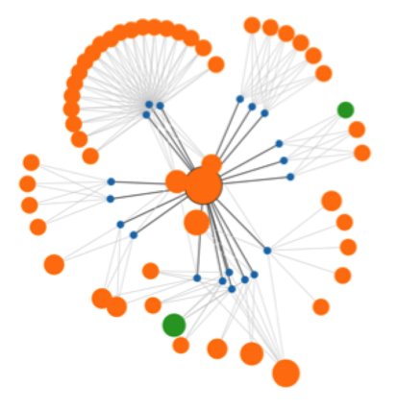


CONTENTMINE Complete OPEN Platform for Mining Scientific Literature
EuPMC, arXiv
CORE , HAL,
(UNIV repos)
Publisher Sites
Figures
query
Data
PloSONE, BMC, peerJ… Nature, IEEE, Elsevier…
PNG
EPS
crawl
getpapers
CSV
XLS
Daily
Crawl
URLs
DOIs
quickscrape
ToC
services
PDF HTML
DOC ePUB
TeX XML
queries
scrapers
Text
UNIV
Repos
Trials
Chem
INFRASTRUCTURE!
Normalizer
Structurer
Semantic
Tagger
COMMUNITY
norma
Phylo
taggers
Crystal
Plants
abstract
Captioned
Figures
search
plugins
methods
Fig. 1
Facts
catalogue
ami
references
HTML tables
Lookup
CONTENT
MINING
30, 000 pages/day Semantic ScholarlyHTML
Visualization
and Analysis

Slide 32
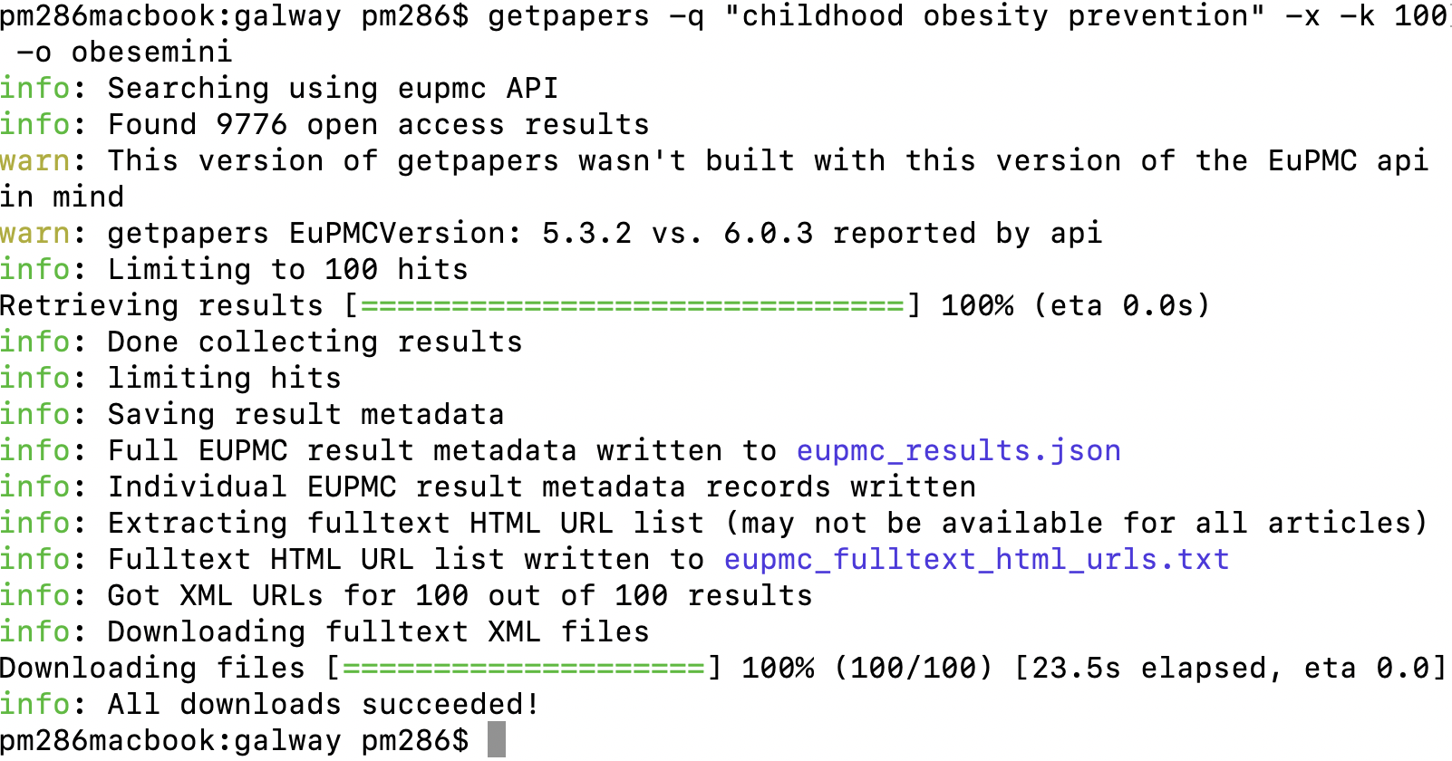
getpapers

Slide 33
ami for ”childhood obesity prevention”
Builtin dictionaries for:
Country
Funders
Drugs
Disease
Bespoke dictionary for Wikipedia “childhood obesity”
Word frequency (cloud)

Slide 34
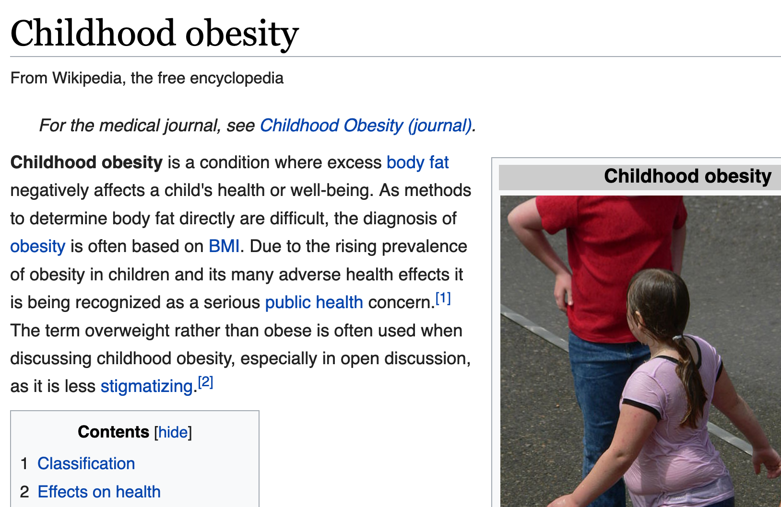
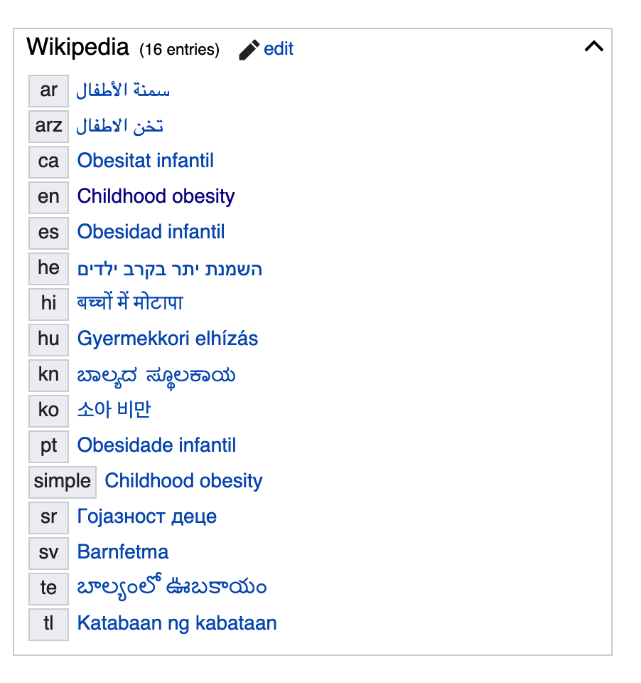
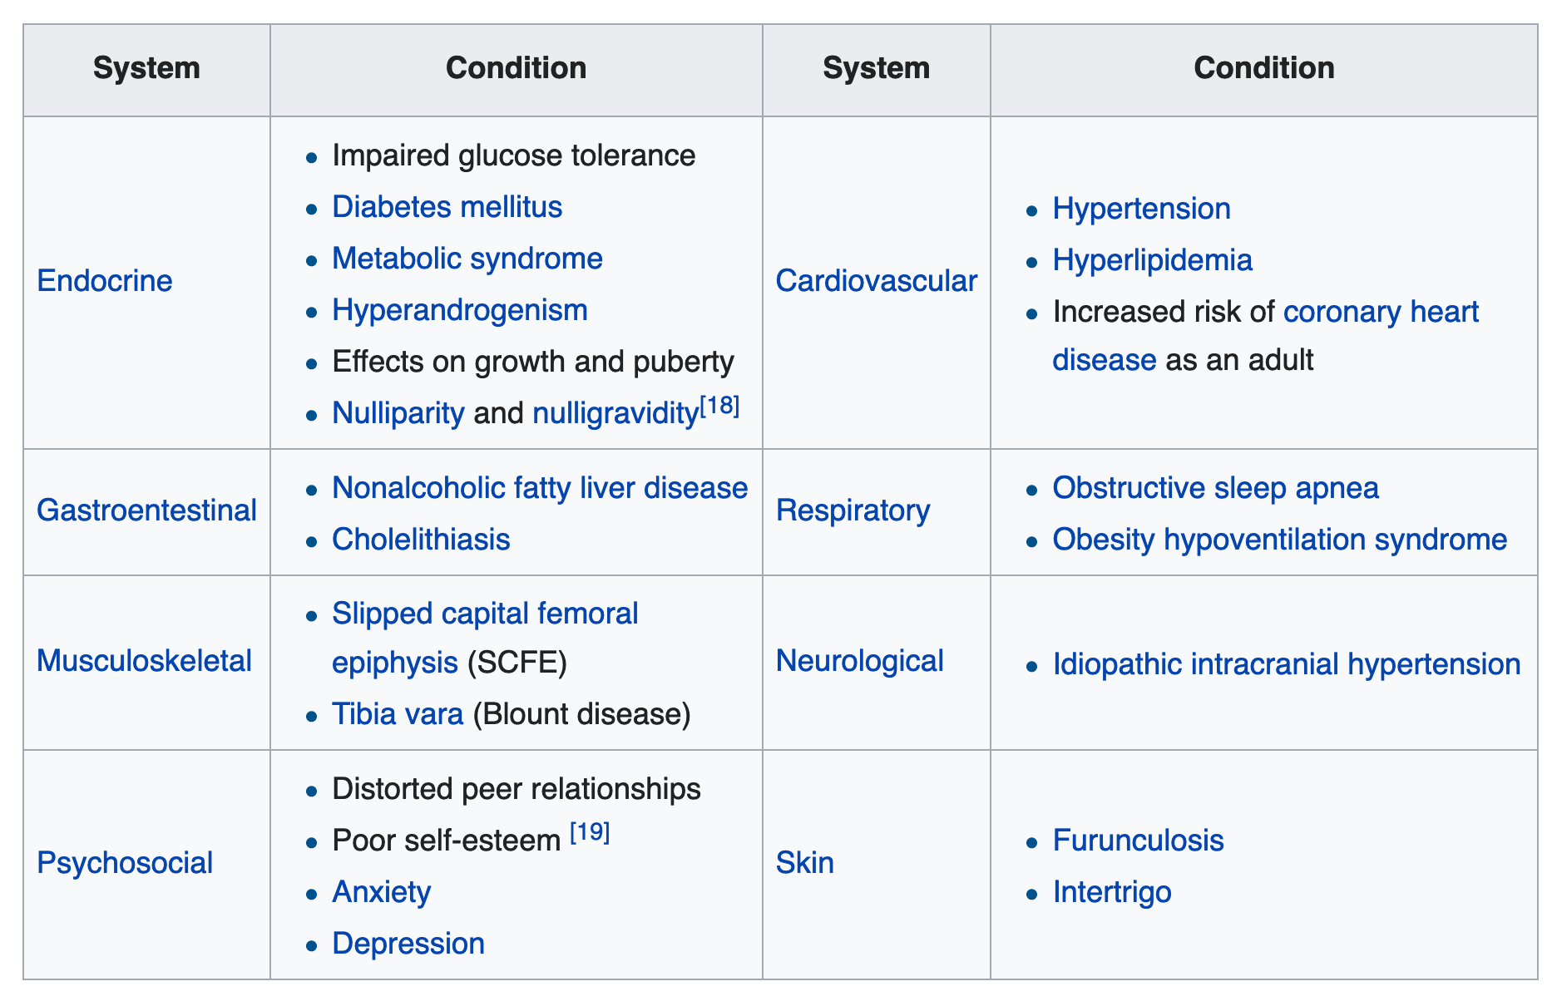
Wikipedia +Wikidata for “childhood obesity”

Slide 35
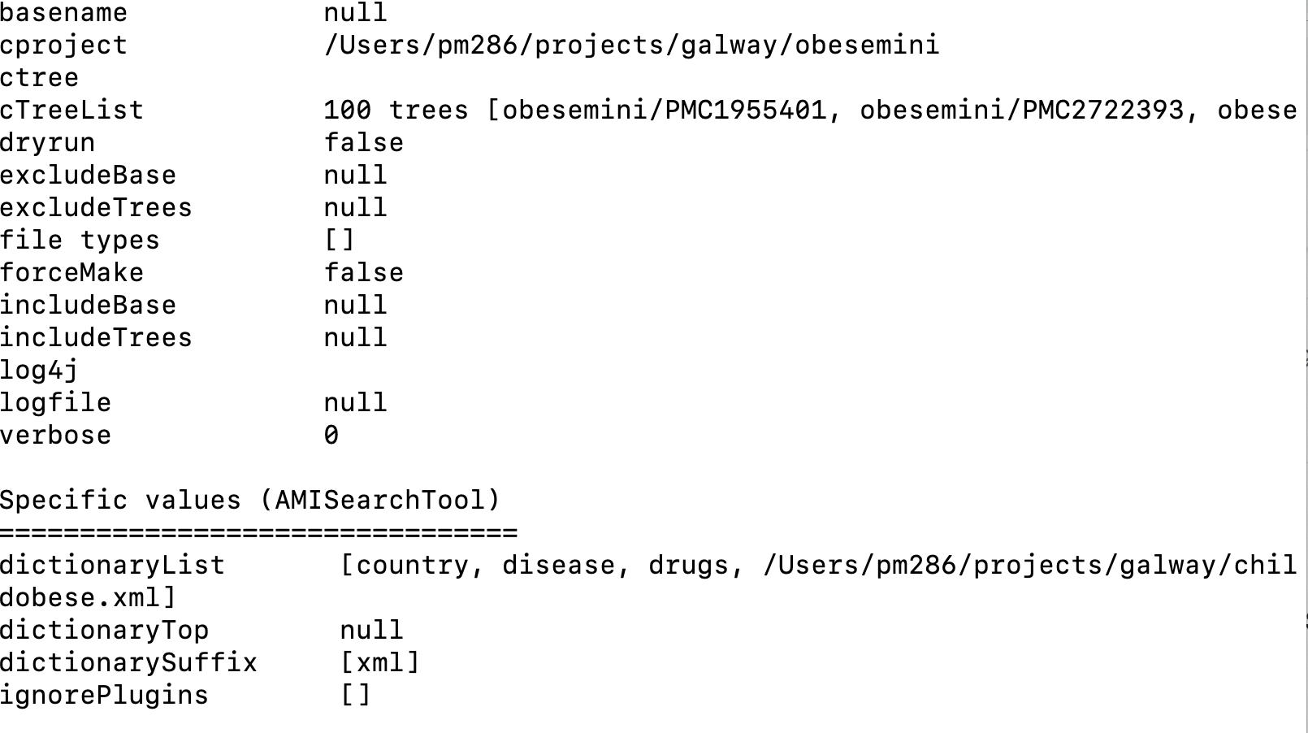
ami-search -p . -–dictionary country disease drugs $PMR/childobese

Slide 36
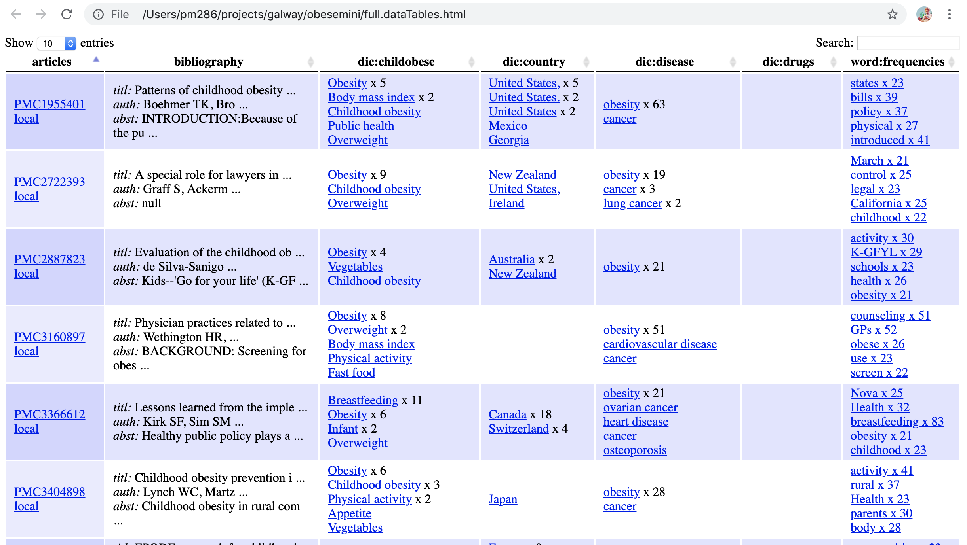

Slide 37
